Slide 1
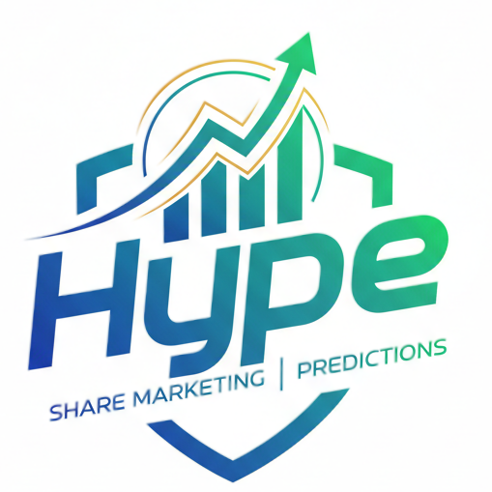
INTRODUCTION
Title of Project: Share Marketing And Predictions Name of the Innovator: Nithin Kamath And Deepak Shenoy
Individual/Team: Hype Team Size:5
Team Leader: N.Poorna sai
Team Members: S.Pradeep,N.Sai kiran,N.Tharun,P.Nithesh

Slide 2

Share Marketing And Predictions
🧠 What Is Share Marketing And Predictions?
Share marketing, also known as stock market investing, involves trading shares of publicly listed companies. When you buy a share, you own a small portion of that company. The market operates through exchanges like the NSE (National Stock Exchange) and BSE (Bombay Stock Exchange) in India

Slide 3

ISSUE OF SHAREMARKETING AND PREDICTIONS:
“Now Days Facing Sharemarketing And Predictions Are market volatility, human emotion/irrationality, the non-linear complexity of financial data, and the difficulty of obtaining consistently accurate predictions due to the Efficient Market Hypothesis (EMH).”

Slide 4

What is Problem Of Sharemarketing And Predictions?
“I am ideating a solution for The core challenge in modern share marketing and prediction is the difficulty of forecasting prices accurately due to the combined forces of market volatility of Share marketing and Prediction

Slide 5

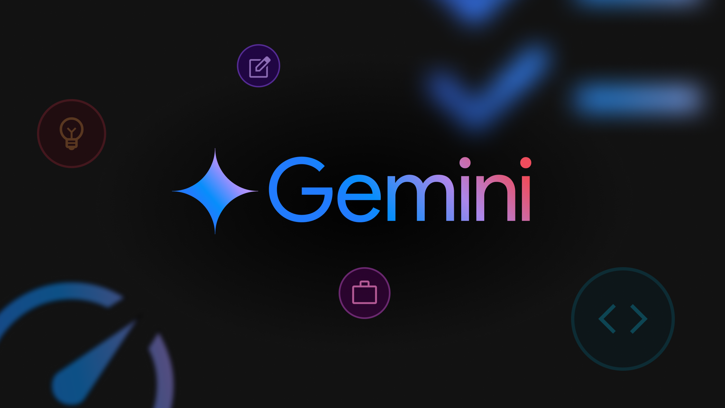

Using of AI Tools For Share Marketing And Predictions:
Gemini AI Used For Images
Chat Gpt Used For Information Of Share Marketing
Love AI Used For Desing The Share Marketing Application

Slide 6
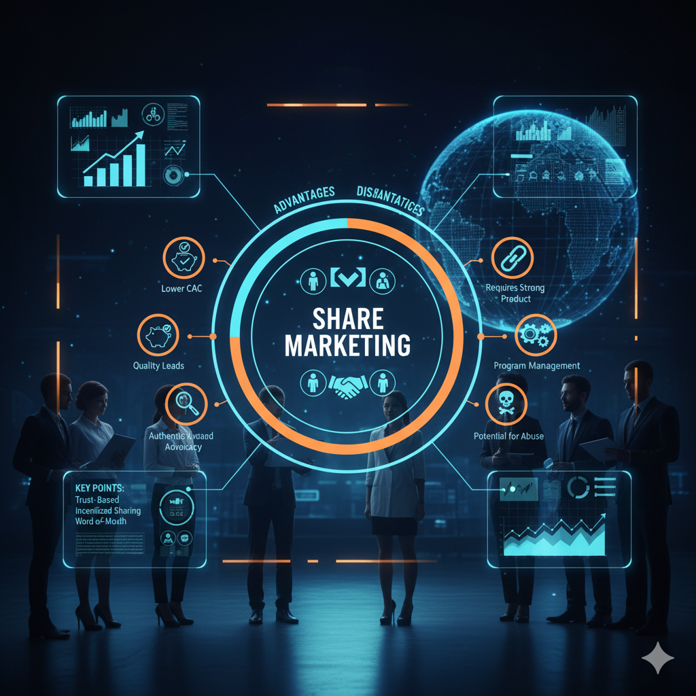
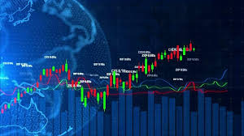
📌 Key Points of Share Marketing
- Ownership: Buying shares makes you a partial owner of a company.
- Returns: Investors earn through capital gains and dividends.
- Liquidity: Shares can be quickly bought or sold on stock exchanges.
- Market Forces: Prices fluctuate based on company performance, economic indicators, and investor sentiment.
- Regulated Platforms: Trading occurs on exchanges like NSE and BSE in India.
Volatility remains high due to global economic shifts and geopolitical tensions.
🔮 Market Predictions (2025 Outlook)
Tech and healthcare sectors show mixed signals—some areas booming, others slowing down.
Data-driven forecasting is gaining traction, using AI and scenario modeling to guide investment decisions.

Slide 7
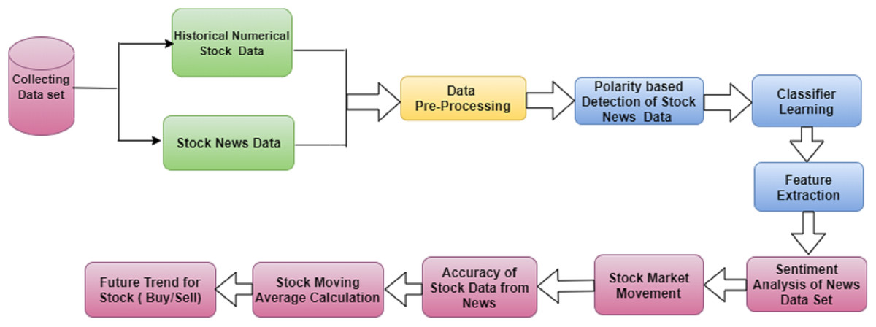
Collection Of Data Flow chart:
Advantages:
Lower CAC: Significantly reduces customer acquisition costs compared to traditional advertising.
Higher LTV & Retention: Referred customers tend to be more loyal, spend more, and stay longer.
Quality Leads: Generates highly qualified leads who are already predisposed to trust the brand.
Authentic Advocacy: Turns satisfied customers into genuine brand evangelists.
Disadvantages:
Requires Strong Product/Service: Only works well if customers are genuinely happy and willing to recommend.
Program Management: Needs careful planning, tracking, and management of incentives to be effective.
Potential for Abuse: Risk of "gaming" the system if not properly designed (e.g., fraudulent referrals).
Limited Scale (Initially): May take time to scale significantly compared to paid advertising campaigns.
Solution Of Share Marketing And Prediction:
“Yes, solving the problems in share marketing and prediction is highly important because accurate forecasting is crucial for economic stability, efficient capital allocation, and maximizing investor profits”

Slide 8
Thankyou…….
“The Best Marketing Doesn’t Feel Like Marketing.”
-----Tom FishburnE
Our Team hype………

